Slide 1
Introduction to JavaScript
Anupama Gupta

Slide 2
Objectives
In this lecture, you will:
Learn about client/server architecture
Add basic JavaScript code to your Web pages
Learn about the JavaScript programming language
Add structure to your JavaScript programs

Slide 3
Understanding Client/Server Architecture
Two-tier system
Client and server
Client or front end
Responsible for user interface
Gathers information from user
Submits information to server
Receives, formats, presents results returned from the server
Server or back end
Usually a database: client requests information

Slide 4
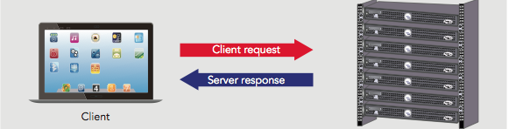
Understanding Client/Server Architecture (cont’d.)
The design of a two-tier client/server system
Web built on a two-tier client/server system
Requests and responses through which a Web browser and Web server communicate happen with HTTP

Slide 5
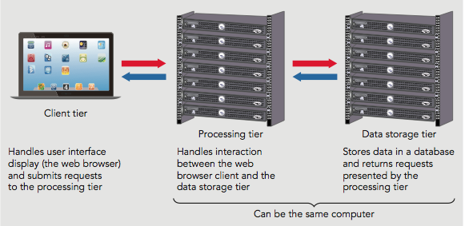
Understanding Client/Server Architecture (cont’d.)
The design of a three-tier client/server system
Three-tier, multitier, client/server system
Client tier
Processing tier
Data storage tier

Slide 6
JavaScript and Client-Side Scripting
Static Web pages
Cannot change after browser renders them
HTML produced static documents
JavaScript
Allows Web page authors to develop interactive Web pages and sites
Client-side scripting language: runs on local browser
Scripting engine executes scripting language code
Scripting host
Web browser containing scripting engine

Slide 7
JavaScript and Client-Side Scripting (cont’d.)
JavaScript history
First introduced in Navigator (Mocha, LiveScript)
Navigator 2.0: name changed to JavaScript 1.0
Microsoft released Internet Explorer 4.0 version of JavaScript (Jscript)
ECMAScript
ECMAScript serves as the standard for the interactive programming languages embedded in all of today’s popular browsers
International, standardized version of JavaScript
Recent versions ES7, ES8, ES9, ES10

Slide 8
JavaScript and Client-Side Scripting (cont’d.)
JavaScript gives a developer the ability to:
Add interactive behavior to web pages
update the content when an event occurs, such as when a user clicks a button
Turn static web pages into applications such as games or calculators
Change the contents of a web page after a browser has rendered it.
Create visual effects such as animation
Create an image lightbox or slider for a smoother image navigation experience
Control the browser window itself

Slide 9
JavaScript and Client-Side Scripting (cont’d.)
Limitations of client-side JavaScript
Cannot be used outside the Web browser
No mechanism for creating a network connection or accessing a database
Cannot run system commands or execute programs on a client

Slide 10
Understanding Server-Side Scripting
Server-side scripting
Scripting language executed from a Web server
Popular languages: PHP, ASP, JSP, Python, Ruby
Can develop interactive Web sites to communicate with a database
Server-side scripting language limitations
Cannot access or manipulate a Web browser
Cannot run on a client tier

Slide 11
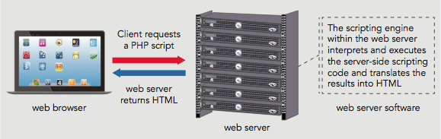
Understanding Server-Side Scripting (cont’d.)
How a Web server processes a server-side script

Slide 12
Should You Use Client-Side or Server-Side Scripting?
General rule of thumb
Allow client to handle user interface processing and light processing (data validation)
Have the Web server perform intensive calculations and data storage
Important to perform as much processing as possible on the client

Slide 13
Adding JavaScript to Your Web Pages
Scripts
JavaScript programs contained within a Web page
<script> element
Tells the browser that the scripting engine must interpret the commands it contains

Slide 14
Adding JavaScript to Your Web Pages
Two ways to add JavaScript to the webpage
External JavaScript
JavaScript code placed in a separate external file
Inline JavaScript
JavaScript code that is embedded with an HTML document

Slide 15
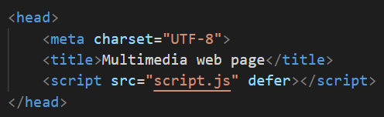
External JavaScript
Code a script element in the head section of the HTML document.
In the script element, the src attribute is used to refer to the external file.
You can also code a type attribute with value “text/javascript” to tell the browser what kind of content the file contains. (Not needed with HTML5)
Note that the defer attribute is used here to have the script run after the page content has loaded. This is useful when you want to use JavaScript to manipulate parts of the page and need the whole page to load first.

Slide 16
Creating a JavaScript Source File
External file containing JavaScript code
Usually designated by the .js file extension
Contains only JavaScript statements
No <script> element and no HTML elements
Use the src attribute of the <script> element
Advantages
Neater code; code sharing; ability to hide JavaScript code from incompatible browsers

Slide 17
Internal JavaScript
You can also write JavaScript code directly into an HTML file.
JavaScript code must start and end with the HTML <script> and </script> tags, respectively.
A document can have multiple <script> tags, each enclosing any number of JavaScript statements.
Statements in a script
Rendered in the order in which they appear in the document

Slide 18
Placing JavaScript in the Document Head or Document Body
<script> element placement varies
The script tag can be placed in HTML document head or document body.
If you want the Java-Script code to be executed before the page is displayed, it is placed between the <head>and </head> tags.
If the script performs some action pertaining to the body of the document, then it is placed within the <body> and </body> tags.

Slide 19
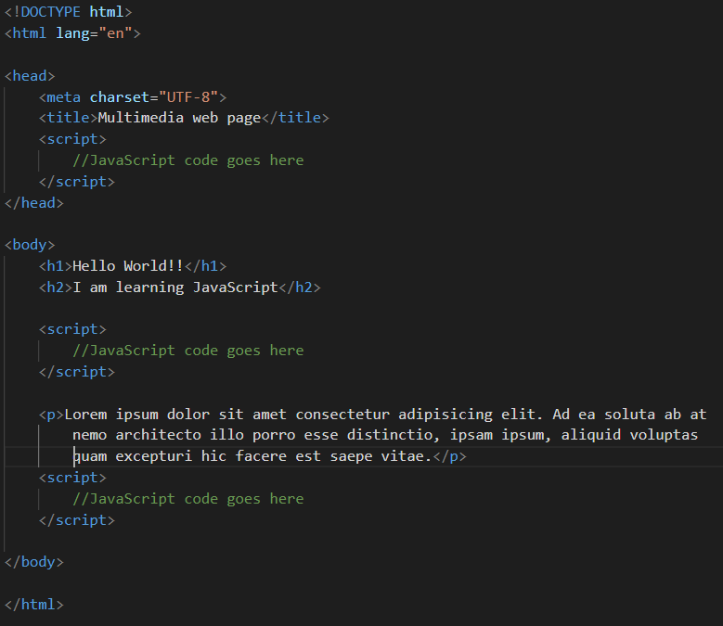
Placing JavaScript in the Document Head or Document Body

Slide 20
Case Sensitivity in JavaScript
JavaScript is case sensitive
Within JavaScript code:
Object names must always be all lowercase

Slide 21
Adding Comments to a JavaScript Program
Comments
Nonprinting lines placed in code containing various types of remarks
Line comment
Hides a single line of code
Add two slashes // before the comment text
Block comments
Hide multiple lines of code
Add /* before the first character included in the block and */ after the last character in the block

Slide 22
Writing Basic JavaScript Code
Learn how to write basic JavaScript code
Start with variables

Slide 23
Using Variables
Variables
Values a program stores in computer memory
Assigning a value to a variable
Same as storing a value in a variable

Slide 24
Assigning Variable Names
Identifier
Name assigned to a variable
Rules and conventions
Must begin with an uppercase or lowercase ASCII letter, dollar sign ($), or underscore ( _ )
Can use numbers in an identifier: not as the first character
Cannot include spaces in an identifier
Cannot use reserved words for identifiers
Use descriptive names
Reserved words (keywords)
Special words: part of the JavaScript language syntax

Slide 25
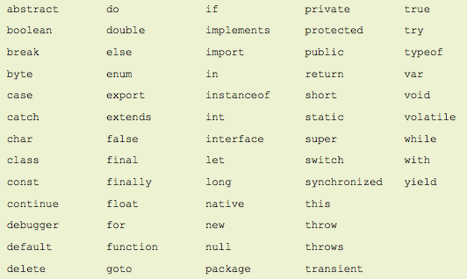
Assigning Variable Names (cont’d.)
JavaScript reserved words

Slide 26
Assigning Variable Names (cont’d.)
Declaring and initializing variables
Use reserved keyword let, const to create variables
Example: let curTime;
Initialize variable using the following syntax:
let variable_name = value;
Assignment operator: equal sign (=)
Assigns value on the right side of the expression to the variable on the left side of the expression
Assigning a literal string value to a variable
Enclose text in quotation marks
Can assign the value of one variable to another

Slide 27
Assigning Variable Names (cont’d.)
Displaying variables: print a variable
Do not enclose it in quotation marks
Perform arithmetic operations involving variables containing numeric values

Slide 28
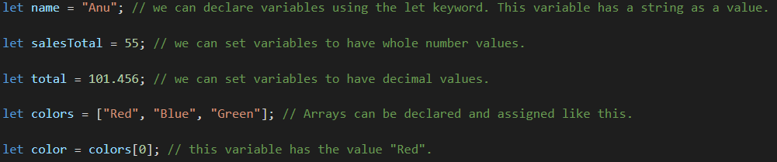
Example

Slide 29

Const Keyword
When you declare a variable with the const keyword, that variable cannot be reassigned.
That is why we refer to it as a constant.
So technically, it is not a variable because it cannot change. It is a constant.

Slide 30
Building Expressions
Expression
Literal value or variable or a combination of literal values, variables, operators, and other expressions
Evaluated by JavaScript interpreter to produce a result
Operands
Variables and literals contained in an expression
Literal
Value such as a literal string or a number
Operators
Symbols used in expressions to manipulate operands

Slide 31
Understanding JavaScript Objects
Object
Programming code and data
Treated as an individual unit or component
Procedures
Individual statements used in a computer program grouped into logical units
Used to perform specific tasks
Methods
Procedures associated with an object

Slide 32
Understanding JavaScript Objects (cont’d.)
Property
Piece of data associated with an object
Assign value to a property using an equal sign
Argument
Information that must be provided to a method
Passing arguments
Providing an argument for a method

Slide 33
Using the write() and writeln() Methods
Document object
Represents content of a browser’s window
The current document (the HTML file that contains the script)
Create new Web page text with the write() method or the writeln() method of the Document object
Both methods require a text string as an argument
Text string or literal string
Text contained within double or single quotation marks
writeln() method adds a line break after the line of text
Notes:
Not a good practice to use since it fires after a page has finished loading, it causes performance issues and sometimes, may not even fire at all.

Slide 34
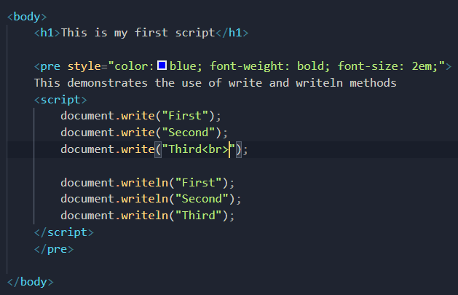
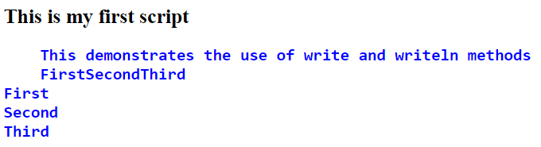
Example

Slide 35
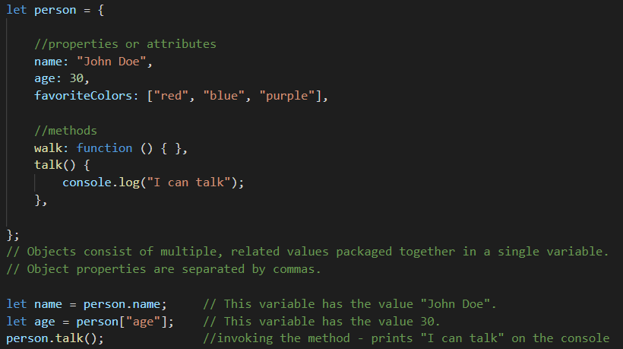
JavaScript Syntax: objects

Slide 36
Developer tools
It is set of web developer tools built right into the web browser that help you
Debug your code
Diagnose problems quickly

Slide 37
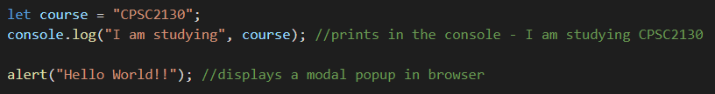
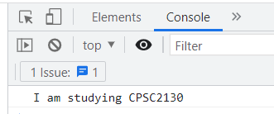
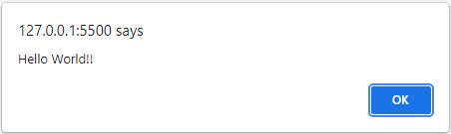
JavaScript – developer tools
Right click on the page, choose Inspect, and find the Console tab.

Slide 38
JavaScript Functions or Methods
Functions help to group a section of code together so that it can be easily executed with a single line. Functions are a good way to avoid writing the same code more than once.
function getIntroduction(course) {
console.log("Starting introduction");
return "Hello, the course is " + course;
}
console.log(getIntroduction(“CPSC2130")); // First prints "Starting introduction" and then "Hello, the course is CPSC2130" in the console.
What would happen if we removed the console.log here?

Slide 39
Window and DOCUMENT OBJECTS
Window is the main JavaScript object, also called the global object.
The root of the document object model (DOM)
Since window is the global object you can reference any properties of it with just the property name
Document is the main object of the potentially visible document object model (DOM).

Slide 40
Prompt and Alert methods
The window.prompt() displays a dialog with an optional message prompting the user to input some text.
It return a string entered by user or null if user clicks cancel
let result = window.prompt(message, default);
The window.alert() method displays an alert box with a specified message.
alert(message)

Slide 41
Example – the test score application
Write an application that asks the user to enter the test scores.
Calculate the total score and average score and display using alert.

Slide 42
JavaScript Syntax: Loops
for (let i = 0; i<10;i++) {
console.log(i);
} //prints all integers from 0 to 9 in the console.
let fruits = ["papaya", "kiwi", "orange"];
fruits.forEach(function(fruit){
console.log(fruit);
}); //prints all three fruit names in the console. This is a good way to run some code on each element of an array. * Note that fruits.forEach() is taking a function as an argument!

Slide 43
JavaScript Syntax: Conditional Logic
Sometimes we want the program to take one of several possible paths depending on a condition:
for (let n = 0; n < 100; n++) {
if (n%2 == 0) { // The double equals sign indicates that we're comparing two things.
console.log("the number " + n + " is even.");
}
else {
console.log("the number " + n + " is odd.");
}
}

Slide 44
JavaScript and Web Pages
JavaScript allows us to access the Document Object Model, which is a way of representing HTML elements as JavaScript objects. We can than write programs to control the way the page works.
<!-- HTML code -->
<div id="container"> <h2>A Heading!</h2>
<p>Some text.</p> </div>
// JavaScript Code
let cont = document.getElementById("container"); // get and store the element with this ID in the cont variable
cont.style.color = "green"; // access and change CSS style properties directly
let heading = cont.querySelector("h2"); // get the first <h2> element inside the cont element
console.log(heading.textContent); // prints "A Heading!" in console

Slide 45
Understanding Events
Event
Specific circumstance monitored by JavaScript
Script can respond to in some way
Allows users to interact with Web pages
Common events: actions users perform
Can also monitor events not resulting from user actions

Slide 46
Understanding Events (cont’d.)
Working with elements and events
Events: associated with HTML elements
Event handler
Code that executes in response to a specific event
HTML allows event handler attributes (e.g., onclick), with JavaScript code, to be added to HTML elements.
JavaScript code for an event handler
Contained within the quotation marks following the name of the JavaScript event handler

Slide 47
Understanding Events (cont’d.)
Referencing web page elements
Use the getElementById() method
Method of the Document object
Uses element's id value
Returns an Element object representing the element whose id property matches the specified string
Allows for the retrieval of information about an element or the ability to change the values assigned to its attributes

Slide 48
Events
JavaScript allows you to "listen" for certain events that can be initiated by the user, such as mouse clicks or keystrokes.
<!-- HTML code -->
<button>Toggle Paragraph</button>
<p>hello!</p>
// JavaScript Code
let button = document.querySelector("button"); // get the first button on the page
button.addEventListener("click", function(event){
// this code will be executed when one clicks on the button
let p = document.querySelector("p"); // get first paragraph
p.classList.toggle("show"); // toggle the show class.
});
There are also different types of events, such as mousemove, keydown, etc.
/* CSS Code */
p { display:none;} .show {display:block;}
Try to guess what this code does!

Slide 49
Summary
Web built on a two-tier client/server system
JavaScript programming language allows for interactive Web pages and sites
<script> element tells Web browser to interpret the commands it contains
Can save JavaScript code in a source file
Writing comments
Use of variables
Understanding Events

Slide 50
References
JavaScript 6th Edition by Sasha Vodnik and Don Gosselin
Web Programming with HTML5, CSS and JavaScript by John Dean
Slides by Jordan Miller

